Slide 1
Bank Loan Case Study
Final Project-2
Project Done By Kaviya

Slide 2
PROJECT DESCRIPTION
This case study aims to give you an idea of applying EDA in a real business scenario. In this case study, apart from applying the techniques that you have learnt in the EDA module, you will also develop a basic understanding of risk analytics in banking and financial services and understand how data is used to minimize the risk of losing money while lending to customers.
APPROACH
The loan providing companies find it hard to give loans to the people due to their insufficient or non-existent credit history. Because of that, some consumers use it as their advantage by becoming a defaulter. As work for a consumer finance company which specializes in lending various types of loans to urban customers. I have to use EDA to analyze the patterns present in the data. This will ensure that the applicants capable of repaying the loan are not rejected.
TECH-STACK USED
Microsoft power point allows you to create various types of documentation and prepare reports. Google colab for python and Microsoft Excel enables users to format, organize, data analysis, and calculate data in a spread sheet, and users can make information easier to view as data is added or changed.
INSIGHTS
The knowledge that I gained from this project identify patterns , Identification of such , driving factors risk analytics and applicants using EDA.
RESULT
I have achieved how to analyze the project , as this helped me to gain more knowledge about EDA to perform better.

Slide 3
Present the overall approach of the analysis. Mention the problem statement and the analysis approach briefly
PROBLEM STATEMENT
Two types of risks are associated with the bank’s decision:
If the applicant is likely to repay the loan, then not approving the loan results in a loss of business to the company.
If the applicant is not likely to repay the loan, i.e. he/she is likely to default, then approving the loan may lead to a financial loss for the company.
APPROACH
DATA UNDERSTANDING | DATA CLEANING AND MANIPULATION | OUTLIER CHECK AND DATA IMBALANCE CHECK | DATA ANALYSIS
Importing correct libraries Checking each, column, Index, header, footer etc. bias Identifying data quality issues | Missing value imputation analysis Checking the structure and the metadata Changing datatypes to date, time, string, int, boot, etc. for ease of analysis | Checking the data for outliers that would cause the analysis to be biased Checking for imbalances, ratio, percentage of imbalance | Business requirement oriented analysis Correlation between columns Univariate analysis Bivariate analysis Creating plots to understand the data better and find insight

Slide 4
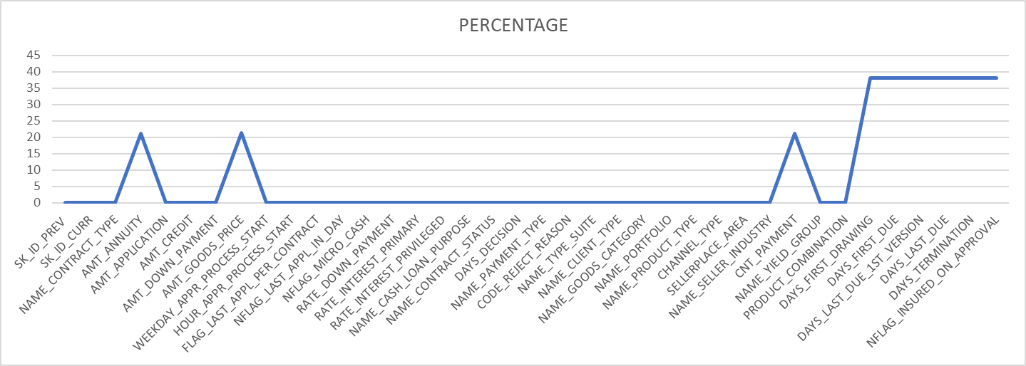
Identify the missing data and use appropriate method to deal with it.
As per Industrial Standard, max threshold limit of missing values can be between 40% to 50 %. Hence, we will remove the 4 columns with over 50% missing values

Slide 5
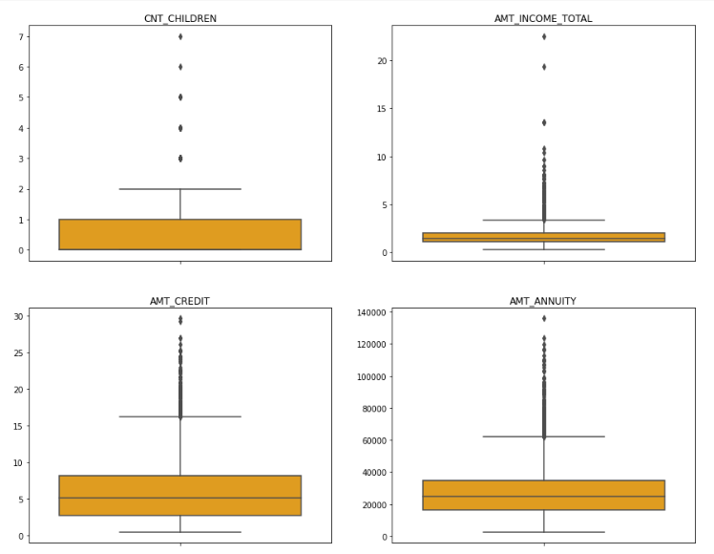
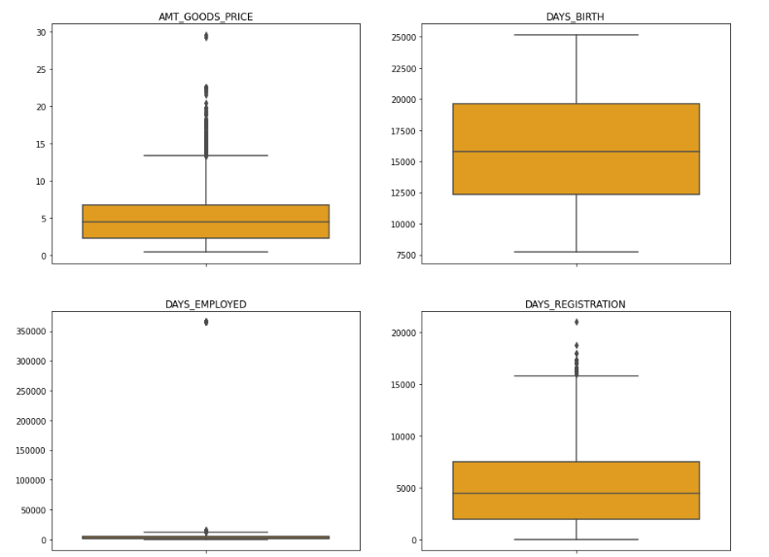
Identify if there are outliers in the dataset. Also, mention why do you think it is an outlier. Again, remember that for this exercise, it is not necessary to remove any data points.
INSIGHTS
It can be seen that in current application data
AMT_ANNUITY, AMT_CREDIT, AMT_GOODS_PRICE,CNT_CHILDREN have some number of outliers.
AMT_INCOME_TOTAL has huge number of outliers which indicate that few of the loan applicants have high income when compared to the others.
DAYS_BIRTH has no outliers which means the data available is reliable.
DAYS_EMPLOYED has outlier values around 350000(days) which is around 958 years which is impossible and hence this has to be incorrect entry.

Slide 6
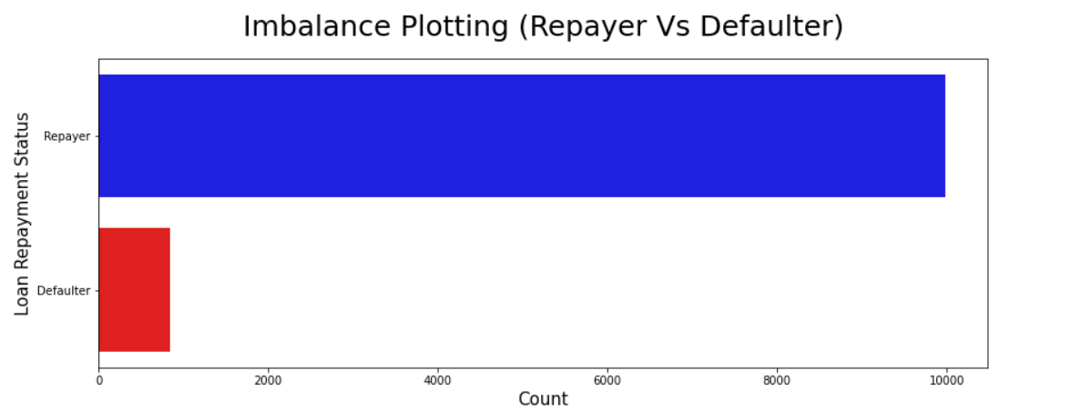
Identify if there is data imbalance in the data. Find the ratio of data imbalance.
Defaulter percentage is 7.76%
Repayer percentage is 92.24%
Imbalance Ratio with respect to Repayer and Defaulter is given:11.89/1(Approx.)

Slide 7
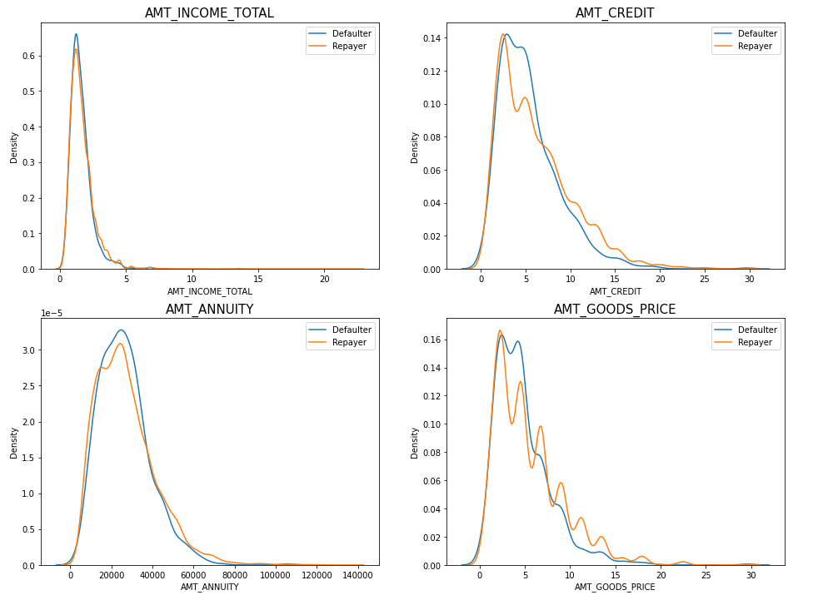
Explain the results of univariate, segmented univariate, bivariate analysis, etc. in business terms.
Univariate analysis is the simplest kind of data analysis in the field of statistics. This could be either descriptive or inferential in nature as is the case in any data analysis in statistics. The key thing about the univariate analysis to remember is that there is only one data involved here, since there are more variables involved in this dataset. So we will conduct bivariate analysis on the following dataset.
Bivariate analysis is stated to be an analysis of any concurrent relation between two variables or attributes. This study explores the relationship of two variables as well as the depth of this relationship to figure out if there are any discrepancies between two variables and any causes of this difference. We have conducted correlation analysis on the basis of our dataset.
INSIGHTS
Most no of loans are given for goods price below 10 lakhs
Most people pay annuity below 50K for the credit loan
Credit amount of the loan is mostly less then 10 lakhs
The repayers and defaulters distribution overlap in all the plots and hence we cannot use any of these variables in isolation to make a decision

Slide 8
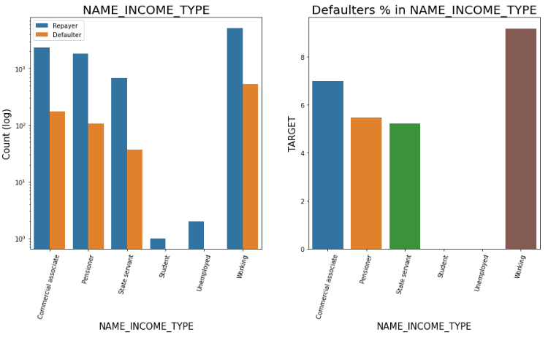
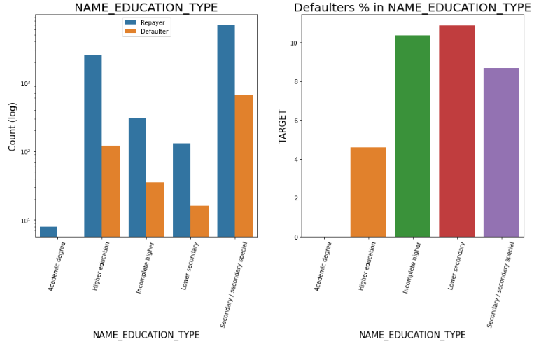
INSIGHTS: Income Type
Most of applicants for loans income type is Working, followed by Commercial associate, Pensioner and State servant.
The applicants who are on Maternity leave have defaulting percentage of 40% which is the highest, followed by Unemployed (37%). The rest under average around 10% defaulter.
Student and Businessmen though less in numbers, do not have default record. Safest two categories for providing loan.
INSIGHTS: Education Type
Majority of clients have Secondary/secondary special education, followed by clients with Higher education.
Very few clients have an academic degree
Lower secondary category have highest rate of defaulting around 11%.
People with Academic degree are least likely to default.

Slide 9
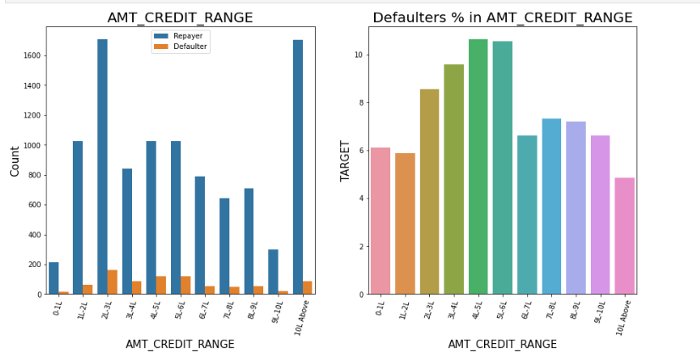
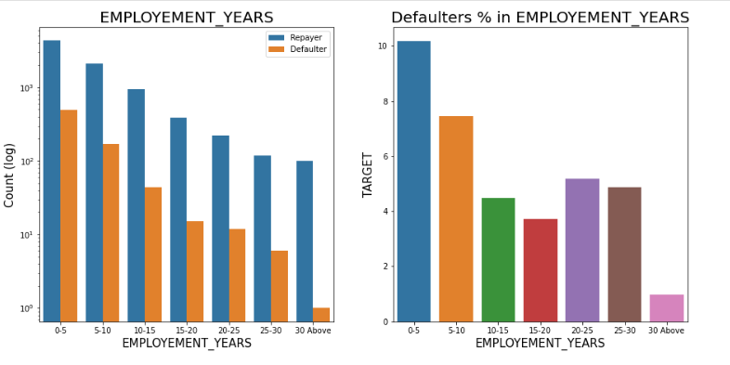
INSIGHTS: Loan Amount
There are high number of applicants have loan in range of 2-3 Lakhs followed by 10 Lakh above range
People who get loan for 3-6 Lakhs have most number of defaulters than other loan range.
INSIGHTS: Employment in Years
Majority of the applicants having working experience between 0-5 years are defaulters. The defaulting rating of this group is also the highest which is around 10%
With increase of employment year, defaulting rate is gradually decreasing.
with people having 30+ year experience have less than 1% default rate

Slide 10
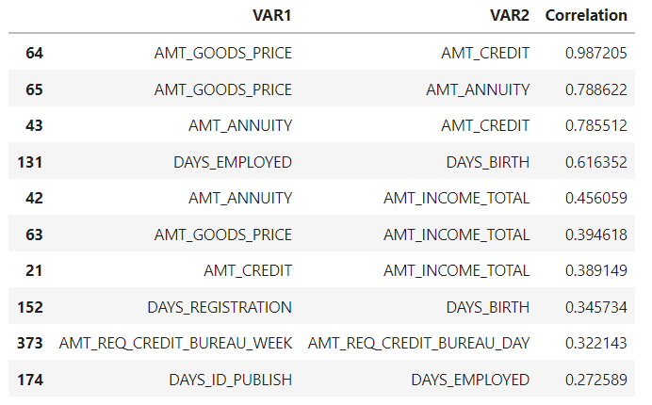
Top 10 correlation for the Repayers
Find the top 10 correlation for the Client with payment difficulties and all other cases (Target variable).

Slide 11
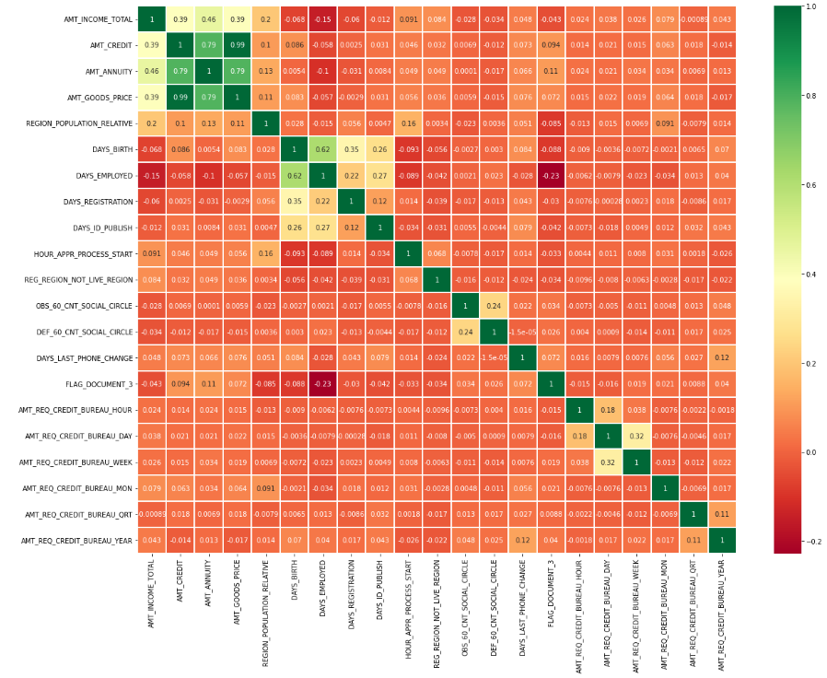
Insights: Correlating factors amongst repayers
1. Credit amount is highly correlated with:
Goods Price Amount
Loan Annuity
Total Income
2. We can also see that repayers have high correlation in number of days employed.

Slide 12
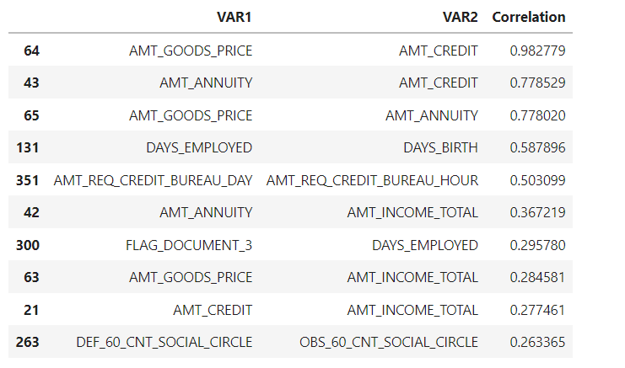
TOP 10 CORRELATION FOR THE DEFAULTER

Slide 13
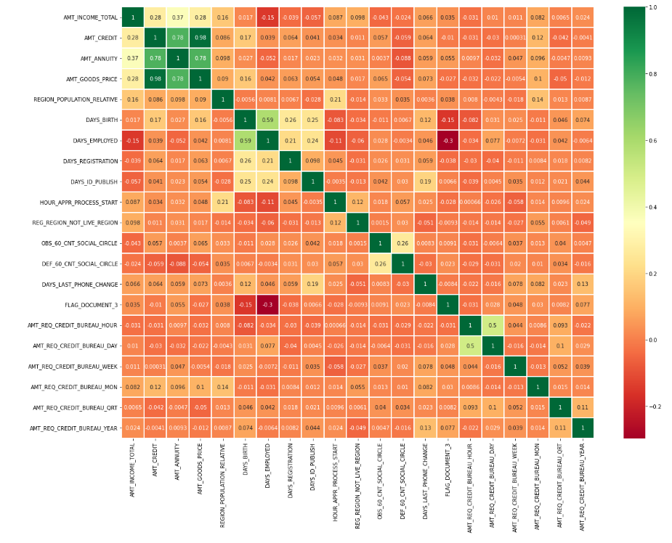
INSIGHTS: CORRELATING FACTORS AMONGST DEFAULTS
Credit amount is highly correlated with good price amount which is same as repayers.
Loan annuity correlation with credit amount has slightly reduced in defaulters(0.78) when compared to repayers(0.79)
We can also see that repayers have high correlation in number of days employed(0.62) when compared to defaulters(0.59).
There is a severe drop in the correlation between total income of the client and the credit amount(0.28) amongst defaulters whereas it is 0.39 among repayers.
There is a slight increase in defaulted to observed count in social circle among defaulters(0.26) when compared to repayers(0.24)

Slide 14
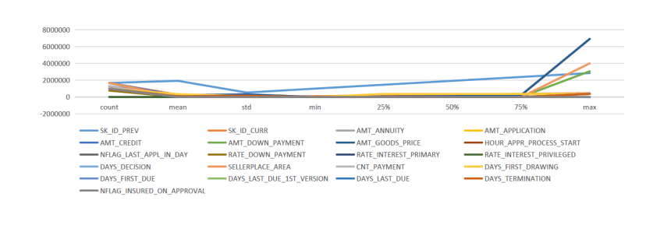
Include visualizations and summarize the most important results in the presentation. You are free to choose the graphs which explain the numerical/categorical variables. Insights should explain why the variable is important for differentiating the clients with payment difficulties with all other cases.

Slide 15
THANK YOU

